Slide 1


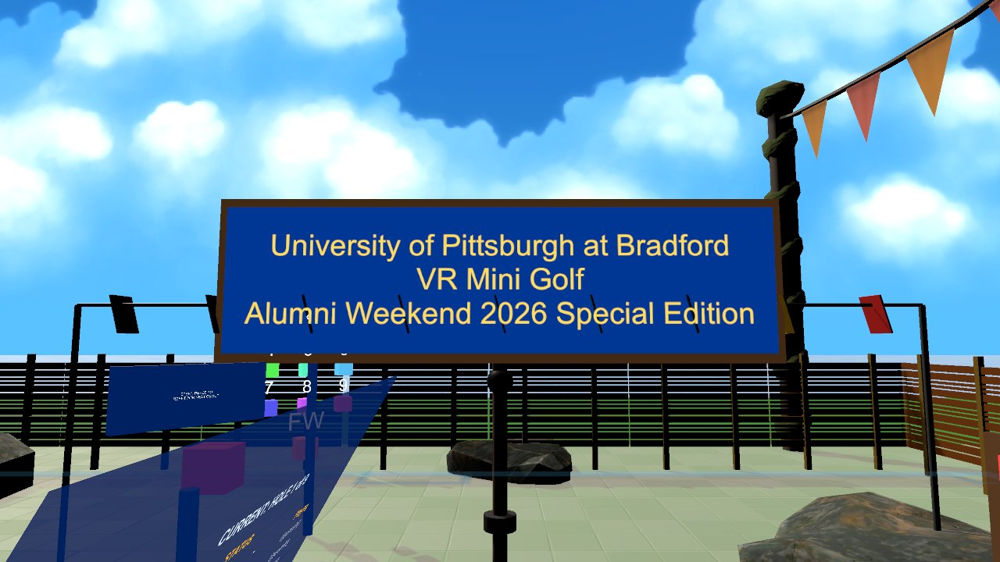

Virtual Reality
Final Showcase: demo your VR / AR / WebXR project live
Wednesdays at 6:00pm
CIST 1423 - 2010 VIRTUAL REALITY PROGRAMMING AND TECHNOLOGY
Final Showcase = 20% of your grade; Final Project = 20%

Slide 2



Agenda
Run of show
Your presentation
Checklist
Stations, order, timing
5 minutes that land
What to have ready before you arrive

Slide 3

Today
By the end of class you can…
Present a finished project in 5 minutes
Tonight's plan
1
0–10
Set up stations
Run a reliable demo station with a reset and a backup
2
10–130
Showcase: 5-min presentations
130–145
Open demo time
145–150
Wrap-up
CIST 1423 — Week 15 — Final Showcase

Slide 4
Your 5 minutes
Same structure as the midterm, now with the whole semester behind it.
Pitch (30 s)
Live demo (2 min)
How it's built (1 min)
What you learned (1 min)
Q&A (30 s)
Who it's for and what they do.
A classmate plays; you narrate. Show the core loop end to end.
Architecture in one picture: scene, scripts, packages.
One bug, one playtest finding, one thing you'd redo.
Be ready for "how would you make it multiplayer?"
CIST 1423 — Week 15 — Final Showcase

Slide 5



Showcase-day checklist
Most failed demos fail before the demo starts.
Build
Backup
Reset
Windows build (.exe + data folder) tested on a lab PC
Or a WebXR URL that loads over the lab Wi-Fi
Starts in the right scene
60-second screen recording
Screenshots in your README
Slides as a PDF on a USB stick
A way to reset between players without taking the headset off
GolfVR's reset kiosk is the model
CIST 1423 — Week 15 — Final Showcase

Slide 6
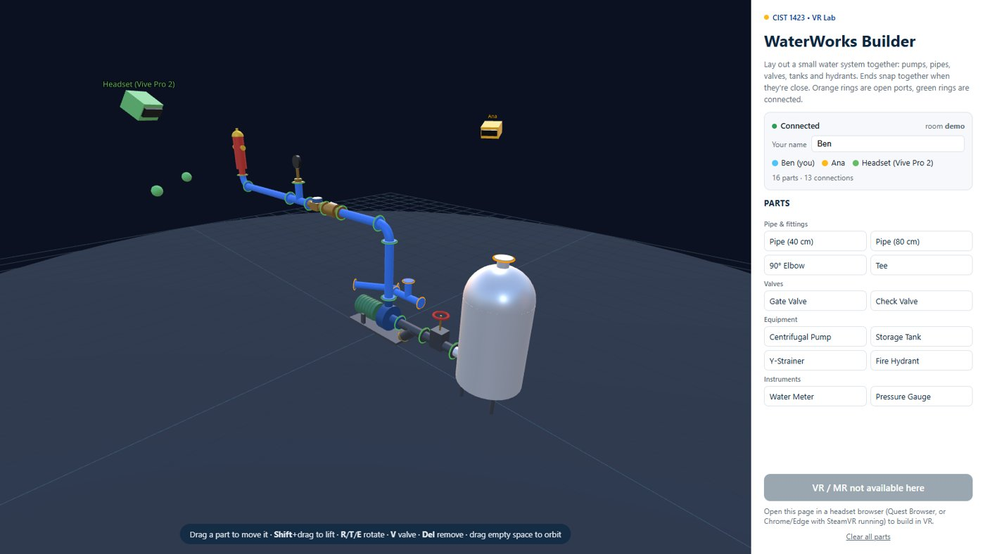
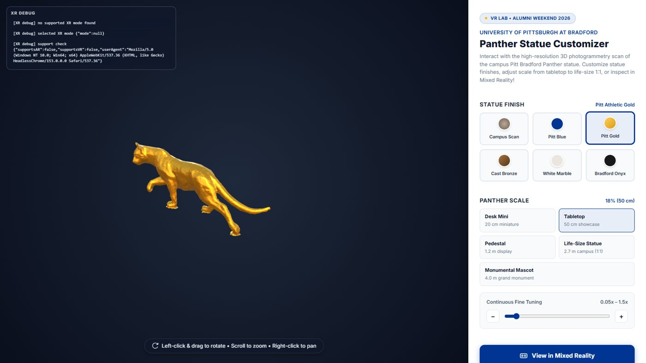
What "showcase ready" looked like at Alumni Weekend
Our own lab ran two showcases for visitors. Use them as a bar to aim for.
GolfVR: welcome sign facing the spawn point, clear first step
WaterWorks: works on headset and laptop, in the same room
panther-builder: one URL, works without a headset too
CIST 1423 — Week 15 — Final Showcase

Slide 7
Check your understanding
Answer with a partner first, then we'll compare.
Q1
Q2
What's in your showcase checklist?
What question should you be ready for?
CIST 1423 — Week 15 — Final Showcase
Notes:
Answers:
Q1. What's in your showcase checklist?
A tested build or URL, a backup video, and a reset.
Q2. What question should you be ready for?
"How would you make it multiplayer?"

Slide 8

Next steps: homework + planning
Present your project live
Final submission and final exam next week
Thank your playtesters in your README
CIST 1423 — Week 15 — Final Showcase

